Slide 1
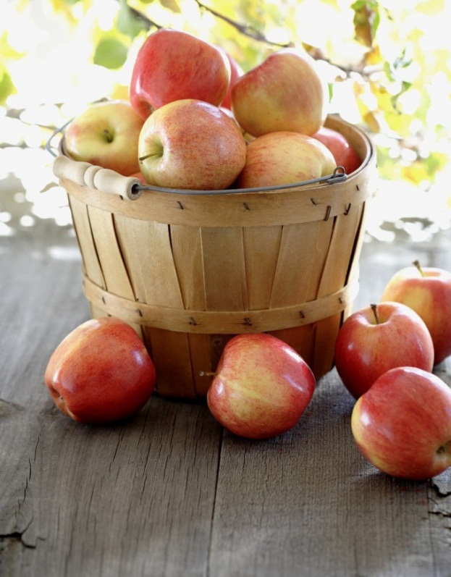

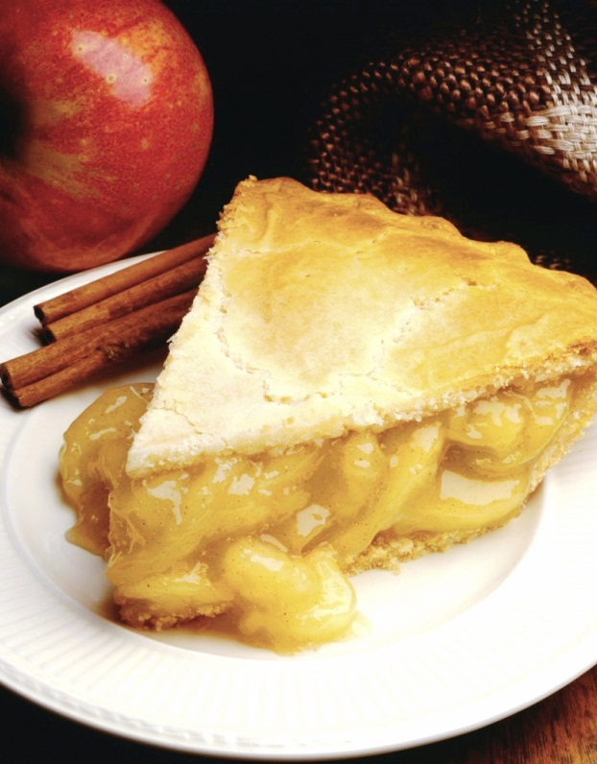
Nutrition Database
Created by Elton Vinh, Joanne Trinh, Gordon Wang, Ethan Huang, Loc Giang, Rama

Slide 2
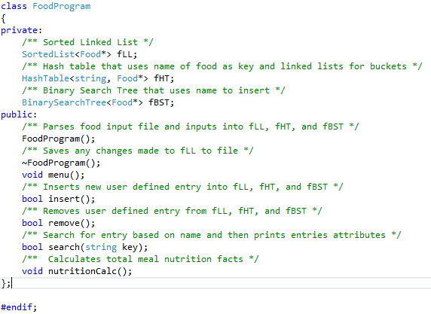
Overview and Features
Food nutrition
Database
Insert
Remove
Search
calculate
HashTable
BST
Sorted Linked List

Slide 3
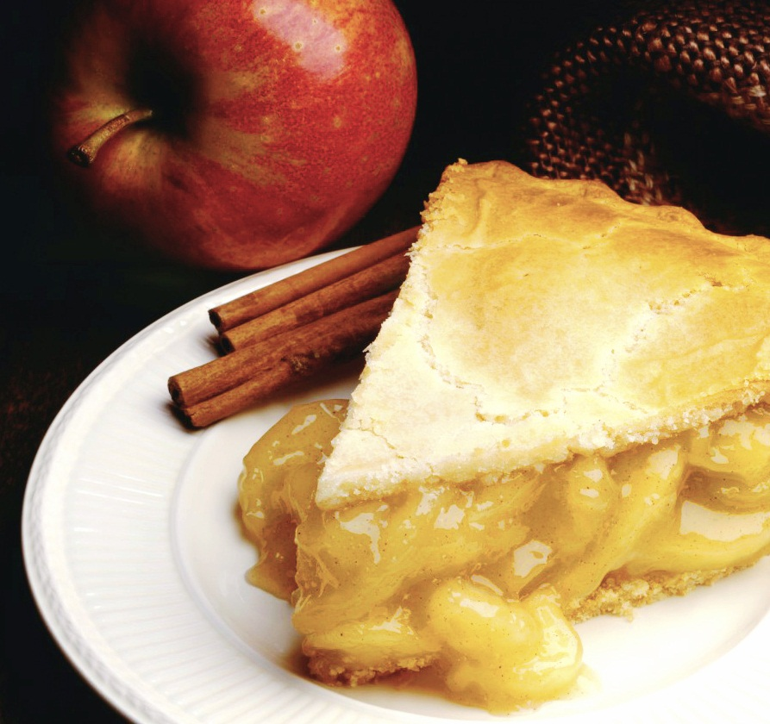

Data Record
Attributes
Name = Tomato
Calories = 15
Total Fat(mg) = 181
Cholesterol(g) = 0
Sodium(mg) = 18
Protein(mg) = 879
Functions
constructors and destructors
getters and setters
overloaded operators

Slide 4
File IO
Name | Calories | Total Fat | Cholesterol | Sodium | Protein
Tomato | 82 | 95
Milk | 76 | 88
Bread | 84 | 90

Slide 5
Data Strutures

Slide 6
Binary Search Tree
Search filters
Print
ascending
descending

Slide 7
Hash Table
Hash Function
Specific look ups

Slide 8

Sorted Linked List
Add your first bullet point here
Add your second bullet point here
Add your third bullet point here

Slide 9
Key Design Efficiencies

